Slide 1
illumination
Sprint 1
By Team 1 Tech Titans

Slide 2
Agenda
Team Member Roles and Responsibilities
Improvements made from Professor Feedback
Project Description
Team Working Agreement
Personas (at least 3)
MVP (Minimum Viable Product)
Technologies
Algorithms
Diagrams
Product Backlog
Sprint 1 Backlog
Metrics
Retrospective
Sprint 2 Plan
Project Demo - Sprint 1
GitHub Link
Live Application Demo

Slide 3
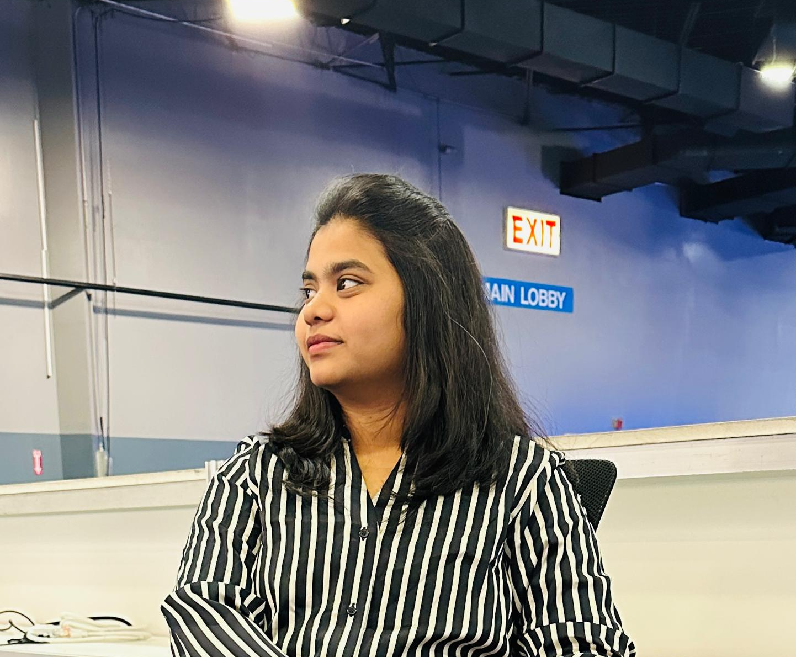


Team Members
Anuhya Marapalli
Rithin Guptha Bajuri
Snehalatha Boothpur
Scrum Master / Developer
Developer
Designer / Developer

Slide 4


Team Members
Harshitha Rangaraju
Srinivas Reddy Bapathu
Team Leader and Developer
Developer and Tester

Slide 5
Improvements
Update in the Product Schedule
Team mail id : Techtitans816@gmail.com

Slide 6
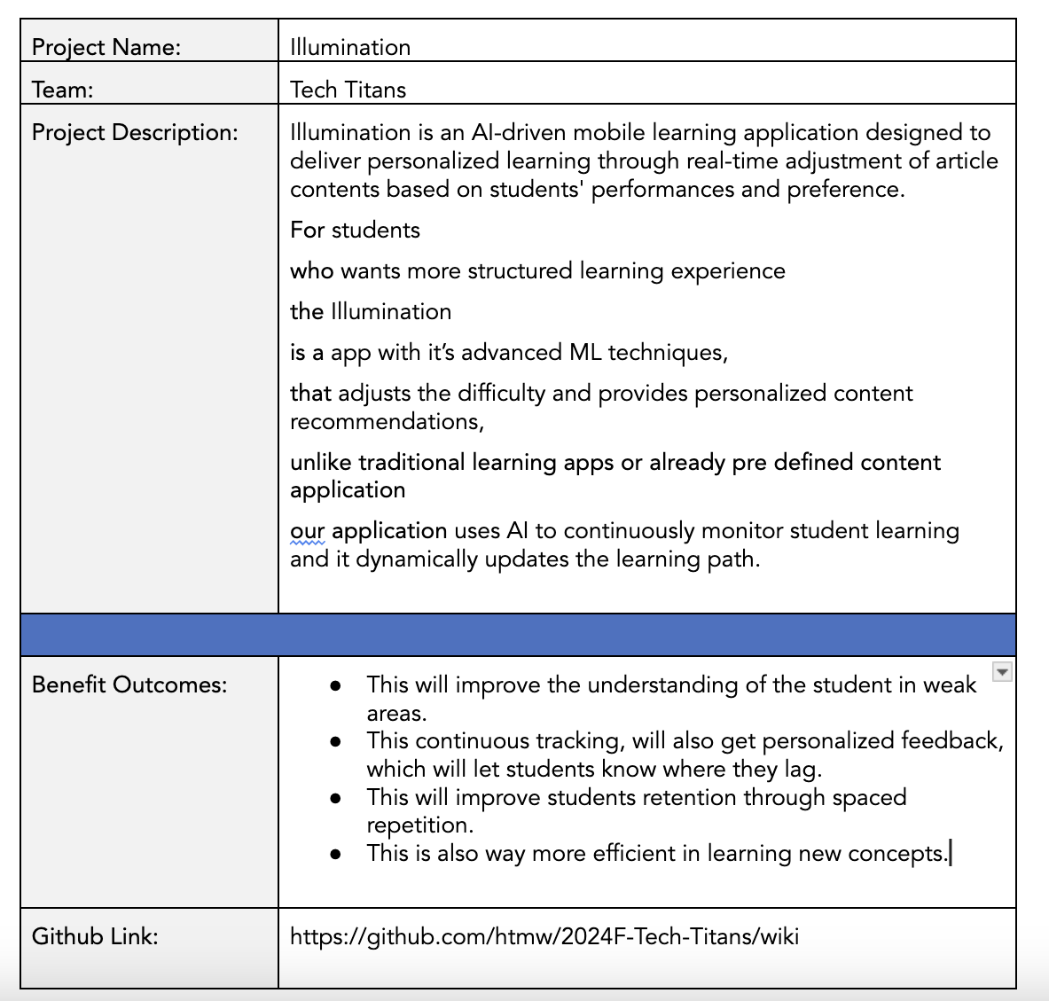
Project Description
BRAND NAME

Slide 7
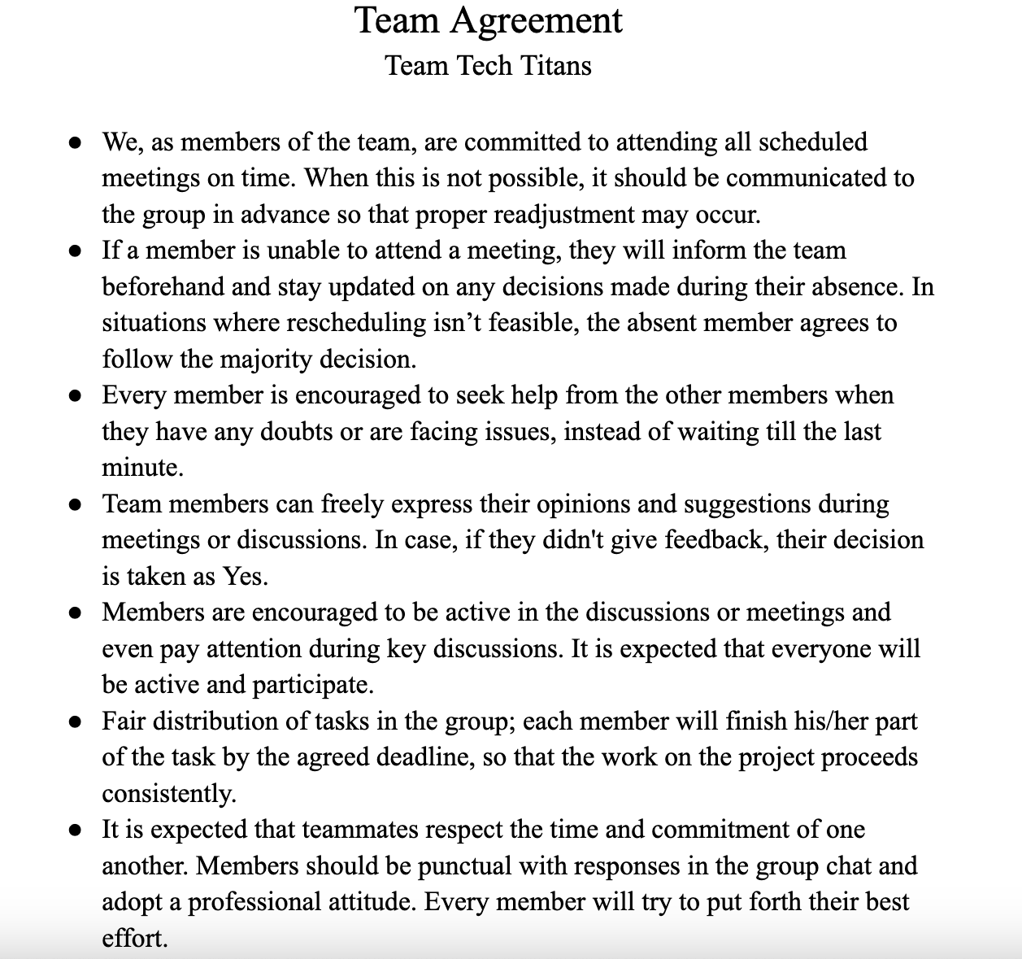
Team Agreement

Slide 8

Ankit, 17 year old
Ankit is a high schooler who is preparing for IIT JEE exams where is he good at Mathematics and Chemistry but he struggles in Physics, even though he attends extra classes, but he never excels it. So, he feels like he personalized study material to improve his weak areas.
Goals:
Have good grasp on difficult physics topics.
Have access to personalized materials on complex topics or topics where he is weak at.
Able to balance school, extra classes and self study.
Challenges
There is a lot of content in online or in books but unable to find proper content for his weakness topics.
Searching for proper material is time taking.
Unable to identify the weak topics.

Slide 9

Rajat, 28 year old
Rajat is CA (Chartered Accountant) aspirant from Mumbai, but he is also working full time in financial firm, which causes him have less time to study. He finds financial reporting and taxation difficult and even struggling to focus because of tight schedule.
Goals:
Improve the understanding of the complex topics.
Able to access the targetted material on the topics which he finds difficult.
Able to balance both work and preparation.
Challenges:
Its difficult to manage both work life and student life which leading him not to study well.
Time consuming on finding the concepts he is weak at.
Struggling to study all because of broad topics in CA.

Slide 10

Kavya, 21 year old
Kavya is engineering student, as she is near her job trails and she is interested in Machine Learning and GenAI, she want to study them and learn them, but she have no idea on machine learning. When she searching of google for roadmap, all those roadmap doesn't suit her well which causes her to distract.
Goals
Master all Machine learning and deep learning concepts.
Able to read fine quality materials which simplify the complex concepts into simple once.
Challenges
There are alot of materials on it which causes to read alot of materials of same topics to understand them.
Facing difficulties in retaining the concepts.
Unable to keep up with the latest trends on ML.

Slide 11
MVP
Subject Selection: Choose subjects to access articles.
Article Reading: Browse and read subject-specific articles.
Mark Articles for Later: Save articles for future review.
Search Functionality: Search articles within a subject.
Personalized Recommendations: Get suggestions based on performance.

Slide 12
Technologies
01.
02.
03.
Backend
Frontend
Tools
fastAPI
Node JS
Mongodb
AWS
Pytorch
React Native
Github
Postman
Google Colab
VSCode

Slide 13





Backend
Here FastAPI is primarily used for machine learning backend tasks where as Node JS is primarily deals with Client Side code. MongoDB for Storing the data. AWS for hosting and even for storing the objective Data. Pytorch for Machine learning

Slide 14

2. Frontend
React Native is used for building cross platform mobile application.

Slide 15




3. Tools
Github is where code and even the documents are shared. Postman is for API Testing. Google Colab for training the Machine Learning Model. VSCode is used for writing the code

Slide 16
Algorithms
Reinforcement Learning
Reinforcement Learning (RL) is a machine learning paradigm where an agent learns by interacting with an environment and receiving rewards for actions. In adaptive learning, RL is used to dynamically adjust content difficulty based on student responses, maximizing engagement and learning efficiency over time.
Word2Vec
Word2Vec is a deep learning-based model that transforms words into continuous vector representations, capturing semantic relationships between words. In content-based filtering, it is used to convert textual content (article text) into vectors, allowing us to measure similarity between content items. Similar vectors imply similar content, enabling personalized recommendations.

Slide 17
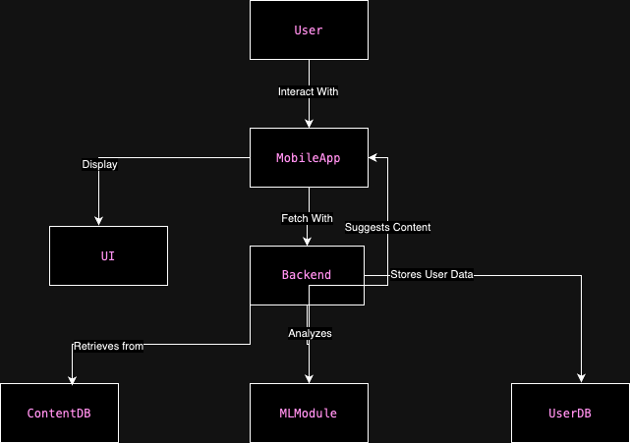
Architecture Diagram

Slide 18
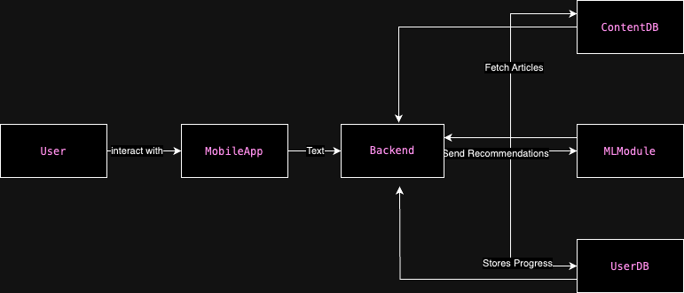
Context Diagram

Slide 19
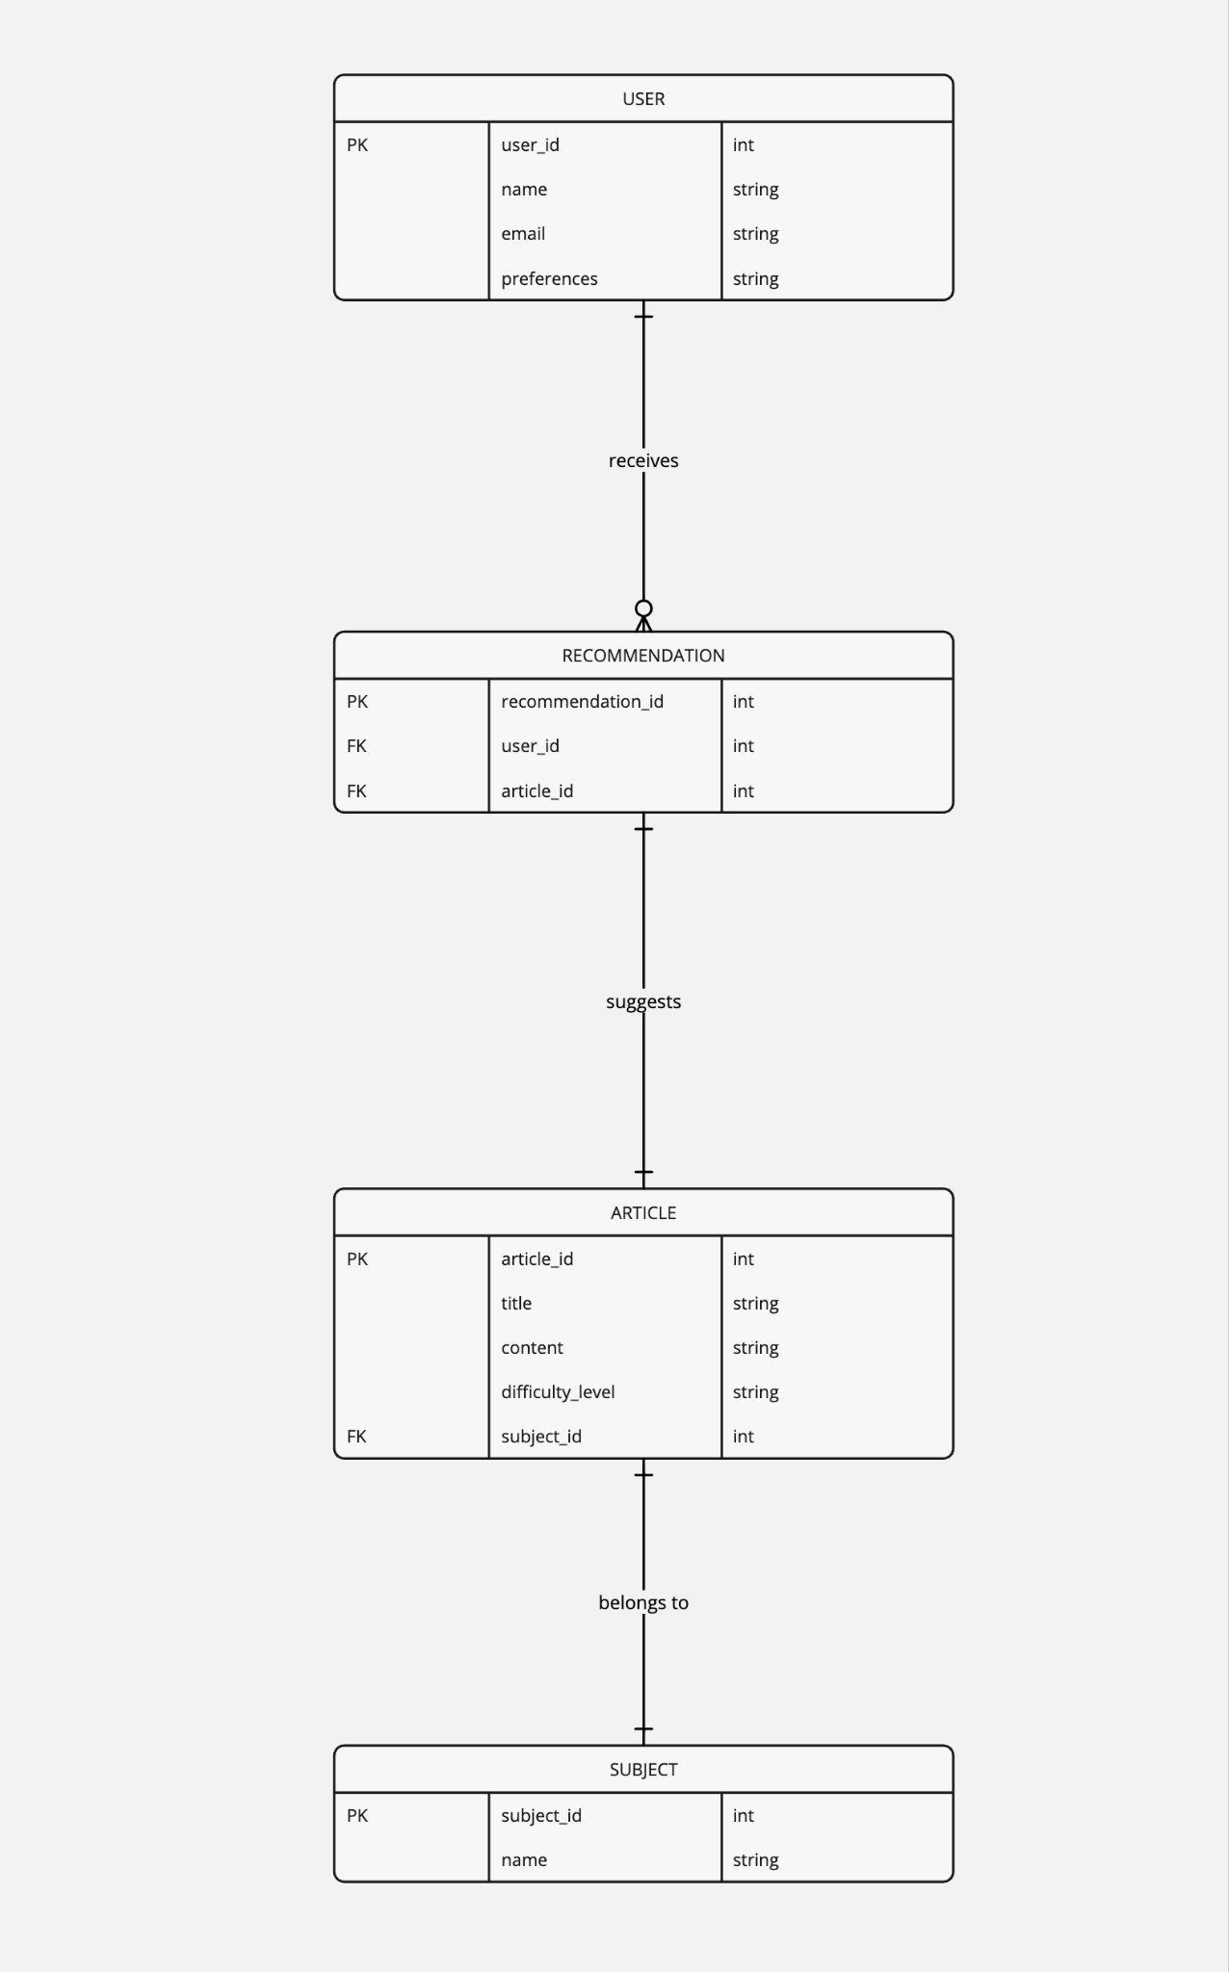
ER Diagram

Slide 20
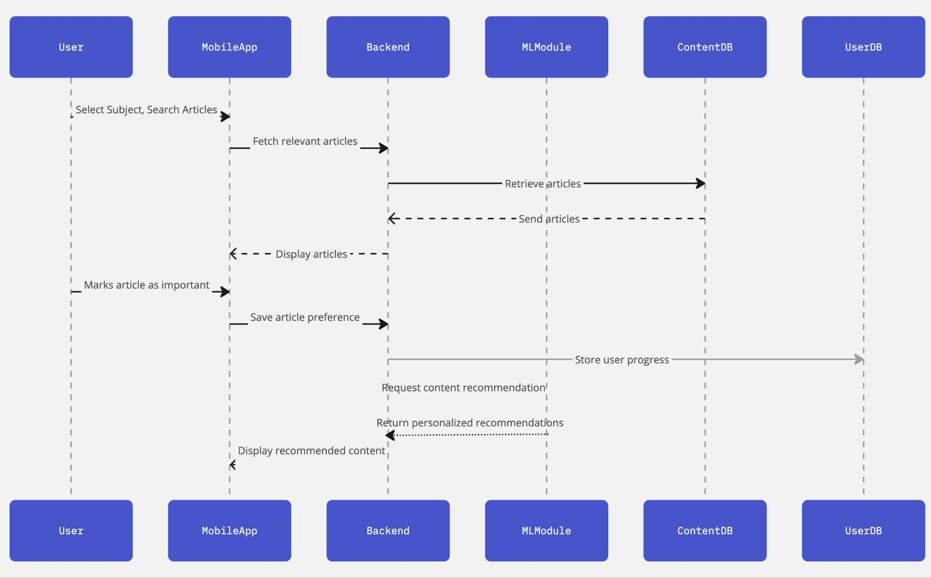
Sequence Diagram

Slide 21
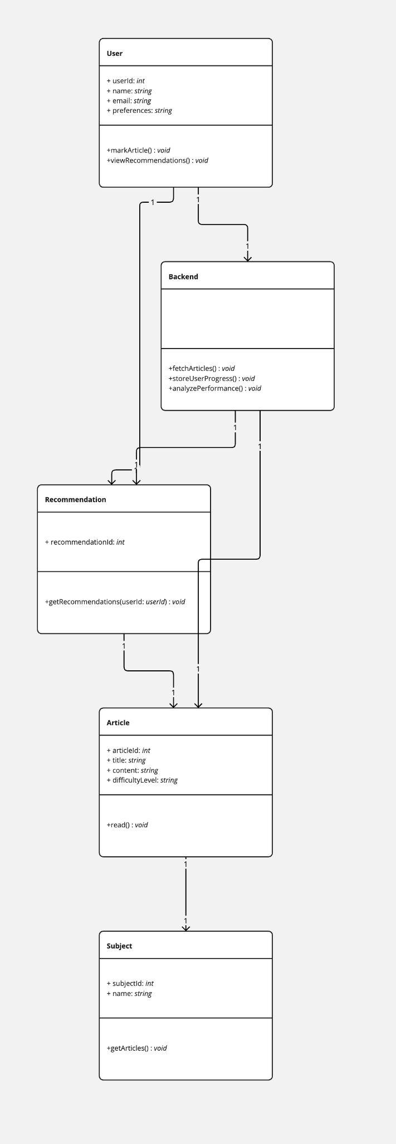
Class Diagram

Slide 22
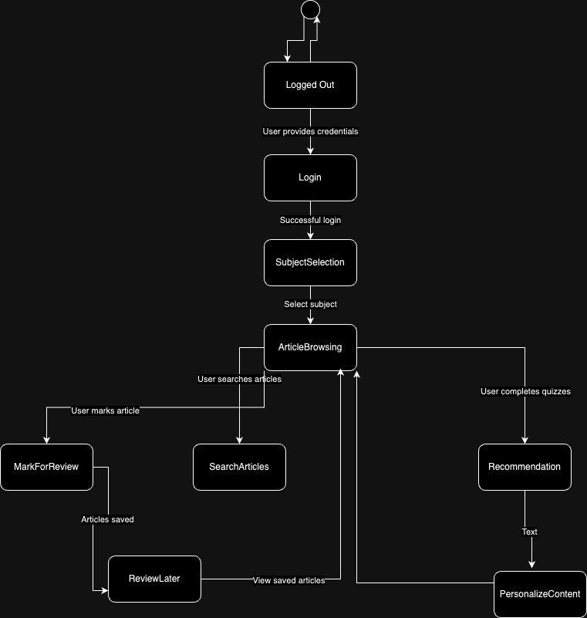
State Diagram

Slide 23
Product Backlog
# | Sprint | Feature | User Story/Technical Story | Acceptance Criteria
1 | Sprint 1 | Subject Selection | User Story 1: As a student, I want to select a subject so I can access relevant learning content. | Users can select from multiple subjects (e.g., Math, Science, History). Selected subjects load relevant articles.
2 | Sprint 1 | Article Reading | User Story 2: As a student, I want to browse and read articles related to the subject I selected. | Articles display in a clean, mobile-friendly interface. Users can scroll and navigate within articles seamlessly.
3 | Sprint 1 | Mark Articles for Later | User Story 3: As a student, I want to mark articles as "difficult" or "important" for later review. | Users can mark articles as "difficult" or "important". Marked articles appear in a "Review Later" section.
4 | Sprint 1 | Article Search | User Story 4: As a student, I want to search for specific articles within a subject. | Users can search for articles by keywords within a subject. Search results are displayed based on relevance.
5 | Sprint 1 | Article Navigation | User Story 5: As a student, I want to navigate between articles within the same subject. | Users can use "next" and "previous" buttons or a navigation bar to move between articles. Ensure smooth transitions.

Slide 24
Product Backlog
# | Sprint | Feature | User Story/Technical Story | Acceptance Criteria
6 | Sprint 1 | Basic UI for Articles | Technical Story 1: Set up basic UI/UX for browsing and reading articles. | Clean, intuitive design for subject selection and article reading. Ensure mobile responsiveness.
7 | Sprint 1 | Content Management System | Technical Story 2: Implement content management system for loading articles by subject. | Articles are stored and categorized by subject. Efficient retrieval of content from a backend system.
8 | Sprint 1 | Mark and Save Articles | Technical Story 3: Add functionality for marking and saving articles for later review. | Users can save marked articles to a "Review Later" list. Data is persisted across sessions.
9 | Sprint 1 | Search Functionality | Technical Story 4: Implement article search functionality. | Enable a search feature within each subject. Search results are displayed quickly and accurately.
10 | Sprint 2 | Personalized Recommendations | User Story 6: As a student, I want personalized content recommendations based on my performance so I can improve weak areas. | The system provides content recommendations based on quiz performance and article difficulty. Users are directed to articles covering weak areas.

Slide 25
Product Backlog
# | Sprint | Feature | User Story/Technical Story | Acceptance Criteria
11 | Sprint 2 | Spaced Repetition | User Story 7: As a student, I want the app to implement spaced repetition to reinforce key concepts over time. | The app identifies and schedules spaced repetition for topics users struggle with. Users are prompted to revisit articles or take quizzes at optimal intervals.
12 | Sprint 2 | Performance Dashboard | User Story 8: As a student, I want to track my progress in a performance dashboard. | The dashboard shows quiz scores, articles read, and time spent on each subject. Users can see areas of strength and weakness visually.
13 | Sprint 2 | Targeted Feedback on Quizzes | User Story 9: As a student, I want to receive targeted feedback after quizzes so I can understand my mistakes. | Detailed feedback is provided for each quiz question. Feedback explains why certain answers are correct/incorrect.
14 | Sprint 2 | Dynamic Content Adjustment | User Story 10: As a student, I want the app to dynamically adjust content difficulty based on my performance. | The difficulty of content increases if the user performs well. If a student struggles, simpler articles or review content is recommended.
15 | Sprint 2 | Basic Machine Learning for Recommendations | Technical Story 5: Implement a basic machine learning model for personalized content recommendations. | The model analyzes quiz performance and article difficulty to recommend personalized learning paths. Adjustments are made based on user progress.

Slide 26
Product Backlog
# | Sprint | Feature | User Story/Technical Story | Acceptance Criteria
16 | Sprint 2 | Spaced Repetition Algorithm | Technical Story 6: Integrate spaced repetition algorithm to reinforce key concepts. | Use spaced repetition techniques to schedule when users should revisit difficult topics. Ensure the system prompts users at the right time for maximum retention.
17 | Sprint 2 | Performance Dashboard Development | Technical Story 7: Build a performance dashboard to visualize progress. | The dashboard shows quiz results, time spent, and subject mastery. Visual charts display performance trends.
18 | Sprint 2 | Quiz Feedback Mechanism | Technical Story 8: Provide detailed quiz feedback for user learning. | Implement feedback mechanisms to explain quiz results. Feedback is both constructive and designed to reinforce learning.
19 | Sprint 3 | User Accounts & Syncing | User Story 11: As a student, I want to create an account and log in so I can save my progress and preferences across devices. | Users can create accounts with email/password. User progress, preferences, and recommendations are saved and synced across devices.
20 | Sprint 3 | Adaptive Study Paths | User Story 12: As a student, I want my study path to adapt based on my long-term learning trends and preferences. | The app uses ML to analyze long-term trends and dynamically adjust learning paths. Preferences are stored, and content is adapted based on user learning styles.

Slide 27
Product Backlog
# | Sprint | Feature | User Story/Technical Story | Acceptance Criteria
21 | Sprint 3 | Reminders for Spaced Repetition & Recommendations | User Story 13: As a student, I want to receive reminders for spaced repetition and personalized study recommendations. | Notifications prompt users for spaced repetition and recommended articles. Reminders are personalized based on past performance and study schedules.
22 | Sprint 3 | Learning History | User Story 14: As a student, I want to view my learning history so I can review previously studied articles and performance. | Users can access their study history, including completed articles and quizzes. History includes quiz scores, article read dates, and time spent.
23 | Sprint 3 | Adaptive Feedback Based on Trends | User Story 15: As a student, I want to receive adaptive feedback based on my performance trends over time so I can improve continuously. | The app provides adaptive feedback based on overall performance and trends. Feedback is more tailored as the system learns from the user’s progress and actions.
24 | Sprint 3 | User Authentication | Technical Story 9: Implement user authentication and profile management. | Secure user authentication system with account creation, login, and password recovery. Ensure user progress and data are stored across sessions.
25 | Sprint 3 | Refined ML for Long-Term Learning | Technical Story 10: Refine the machine learning model for adaptive feedback based on long-term learning trends. | The ML model adapts based on user learning patterns and feedback. Ensure the model evolves based on long-term trends and personalized learning data.

Slide 28
Product Backlog
# | Sprint | Feature | User Story/Technical Story | Acceptance Criteria
26 | Sprint 3 | Reminders & Notifications | Technical Story 11: Implement reminders and notifications for spaced repetition and content recommendations. | Notifications are sent based on spaced repetition schedules and content recommendations. Ensure reminders are relevant and personalized to user learning paths.
27 | Sprint 3 | Final UI/UX Improvements | Technical Story 12: Finalize UI/UX improvements for a polished, engaging user experience. | Refine the user interface for a smooth, intuitive experience. Ensure the app is fully responsive and accessible on different devices.

Slide 29
Sprint 1
# | Story/Task (User Story or Technical Story) | Story Points
1 | User Story 1: As a student, I want to select a subject so I can access relevant learning content. | 3 Points | Users can select from multiple subjects (e.g., Math, Science, History). Selected subjects load relevant articles.
2 | User Story 2: As a student, I want to browse and read articles related to the subject I selected. | 5 Points | Articles display in a clean, mobile-friendly interface. Users can scroll and navigate within articles seamlessly.
3 | User Story 3: As a student, I want to mark articles as "difficult" or "important" for later review. | 3 Points | Users can mark articles as "difficult" or "important". Marked articles appear in a "Review Later" section.
4 | User Story 4: As a student, I want to search for specific articles within a subject. | 8 Points | Users can search for articles by keywords within a subject. Search results are displayed based on relevance.
5 | User Story 5: As a student, I want to navigate between articles within the same subject. | 2 Points | Users can use "next" and "previous" buttons or a navigation bar to move between articles. Ensure smooth transitions.
Acceptance Criteria

Slide 30
Sprint 1
# | Story/Task (User Story or Technical Story) | Story Points
6 | Technical Story 1: Set up basic UI/UX for browsing and reading articles. | 5 Points | Clean, intuitive design for subject selection and article reading. Ensure mobile responsiveness.
7 | Technical Story 2: Implement content management system for loading articles by subject. | 5 Points | Articles are stored and categorized by subject. Efficient retrieval of content from a backend system.
8 | Technical Story 3: Add functionality for marking and saving articles for later review. | 3 Points | Users can save marked articles to a "Review Later" list. Data is persisted across sessions.
9 | Technical Story 4: Implement article search functionality. | 8 Points | Enable a search feature within each subject. Search results are displayed quickly and accurately.
Acceptance Criteria
Total 42 Points

Slide 31
Test Cases
Story/Task | Test Case ID | Test Case Description | Preconditions | Steps | Expected Result | Status
User Story 1: Subject Selection | TC-1.1 | Verify that a user can select a subject from a predefined list. | Subject list is available in the app. | 1. Open the app. 2. Select a subject from the list. 3. Confirm subject loads correctly. | The subject is selected, and relevant articles load. | Pass
 | TC-1.2 | Verify subjects load correctly based on user selection. | Subject list is available. | 1. Select each subject. 2. Ensure the correct articles for each subject are displayed. 3. Navigate to a subject. | The articles related to the selected subject are loaded. | Pass
User Story 2: Browse and Read Articles | TC-2.1 | Verify that articles display correctly in a mobile-friendly layout. | Subject has been selected, and articles are available. | 1. Select a subject. 2. Open an article. 3. Scroll through the article. | Articles display properly and scrolling is smooth. | Pass
 | TC-2.2 | Verify article readability and responsiveness across devices. | Articles are loaded in the app. | 1. Open an article. 2. Check readability on mobile and tablet devices. 3. Resize the window to ensure responsiveness. | Article content is legible and the layout adapts to different devices. | Pass

Slide 32
Test Cases
Story/Task | Test Case ID | Test Case Description | Preconditions | Steps | Expected Result | Status
User Story 3: Mark Articles for Review | TC-3.1 | Verify marking an article as "difficult" or "important". | An article is displayed. | 1. Open an article. 2. Mark it as "difficult". 3. Mark it as "important". | Article is successfully marked as "difficult" or "important". | Pass
 | TC-3.2 | Verify that marked articles appear in the "Review Later" section. | One or more articles are marked. | 1. Mark articles. 2. Navigate to the "Review Later" section. 3. Check that the marked articles appear. | Marked articles are listed in the "Review Later" section. | Pass
User Story 4: Search for Articles | TC-4.1 | Verify search results match keywords entered by the user. | Articles are available in the selected subject. | 1. Open the search bar. 2. Enter a keyword. 3. Execute the search. | Relevant articles based on the keyword are returned. | Pass
 | TC-4.2 | Verify the speed and accuracy of the search functionality. | Articles are available. | 1. Open the search bar. 2. Enter a variety of keywords. 3. Test search speed. 4. Ensure results are accurate. | Search results are returned quickly, and accuracy is maintained. | Pass

Slide 33
Test Cases
Story/Task | Test Case ID | Test Case Description | Preconditions | Steps | Expected Result | Status
User Story 5: Navigate Between Articles | TC-5.1 | Verify that "next" and "previous" buttons navigate between articles. | At least two articles are available in the subject. | 1. Open an article. 2. Use the "next" button to move to the next article. 3. Use the "previous" button to go back. | The user is able to navigate between articles smoothly. | Pass
 | TC-5.2 | Ensure smooth transitions between articles when navigating. | At least two articles are available. | 1. Open an article. 2. Navigate between articles using the "next" and "previous" buttons. 3. Check for any delays or disruptions during transitions. | Transitions between articles are smooth without delay or disruption. | Pass
Technical Story 1: Basic UI/UX Setup | TC-6.1 | Verify UI layout for subject selection and article reading. | App is accessible. | 1. Open the app. 2. Browse the subject list. 3. Select a subject and read an article. 4. Check UI consistency and readability. | The UI is intuitive, and articles are displayed in a clean, readable format. | Pass
 | TC-6.2 | Test mobile responsiveness of the UI/UX. | App is accessible on mobile devices. | 1. Open the app on mobile. 2. Browse the subject and article pages. 3. Check for UI consistency and responsiveness to different screen sizes. | The UI is responsive and works smoothly on mobile devices. | Pass

Slide 34
Test Cases
Story/Task | Test Case ID | Test Case Description | Preconditions | Steps | Expected Result | Status
Technical Story 2: Content Management | TC-7.1 | Verify that articles are correctly categorized by subject. | Content is loaded into the backend. | 1. Open the app. 2. Select each subject. 3. Ensure articles appear under the correct subject categories. | Articles are correctly categorized and load under the appropriate subjects. | Pass
 | TC-7.2 | Test efficiency of content retrieval from the backend. | Backend content is available. | 1. Open the app. 2. Select a subject. 3. Time how long it takes for the articles to load. 4. Test under different network conditions. | Articles are retrieved quickly, even under varied network conditions. | Pass
Technical Story 3: Mark and Save Articles | TC-8.1 | Verify marked articles persist across user sessions. | Articles are marked for review. | 1. Mark an article for review. 2. Close the app. 3. Reopen the app and check that the marked article persists. | Marked articles are saved and persist across sessions. | Pass
Technical Story 4: Search Functionality | TC-9.1 | Verify that search results are relevant and load quickly. | Articles are available for search. | 1. Open the search bar. 2. Search for a term. 3. Measure the time taken to display results. 4. Check relevance of displayed articles. | Search results are quick and relevant. | Pass

Slide 35
Test Cases
Story/Task | Test Case ID | Test Case Description | Preconditions | Steps | Expected Result | Status
Technical Story 2: Content Management | TC-7.1 | Verify that articles are correctly categorized by subject. | Content is loaded into the backend. | 1. Open the app. 2. Select each subject. 3. Ensure articles appear under the correct subject categories. | Articles are correctly categorized and load under the appropriate subjects. | Pass
 | TC-7.2 | Test efficiency of content retrieval from the backend. | Backend content is available. | 1. Open the app. 2. Select a subject. 3. Time how long it takes for the articles to load. 4. Test under different network conditions. | Articles are retrieved quickly, even under varied network conditions. | Pass
Technical Story 3: Mark and Save Articles | TC-8.1 | Verify marked articles persist across user sessions. | Articles are marked for review. | 1. Mark an article for review. 2. Close the app. 3. Reopen the app and check that the marked article persists. | Marked articles are saved and persist across sessions. | Pass
Technical Story 4: Search Functionality | TC-9.1 | Verify that search results are relevant and load quickly. | Articles are available for search. | 1. Open the search bar. 2. Search for a term. 3. Measure the time taken to display results. 4. Check relevance of displayed articles. | Search results are quick and relevant. | Pass

Slide 36
Sprint 1 Completed Stories
Story/Task | Story Points
User Story 1: Subject Selection | 3 Points
User Story 2: Browse and Read Articles | 5 Points
User Story 3: Mark Articles for Review | 3 Points
User Story 4: Search for Articles | 8 Points
User Story 5: Navigate Between Articles | 2 Points
Technical Story 1: Basic UI/UX Setup | 5 Points
Technical Story 2: Content Management System | 5 Points
Technical Story 3: Mark and Save Articles | 3 Points
Technical Story 4: Search Functionality | 8 Points

Slide 37
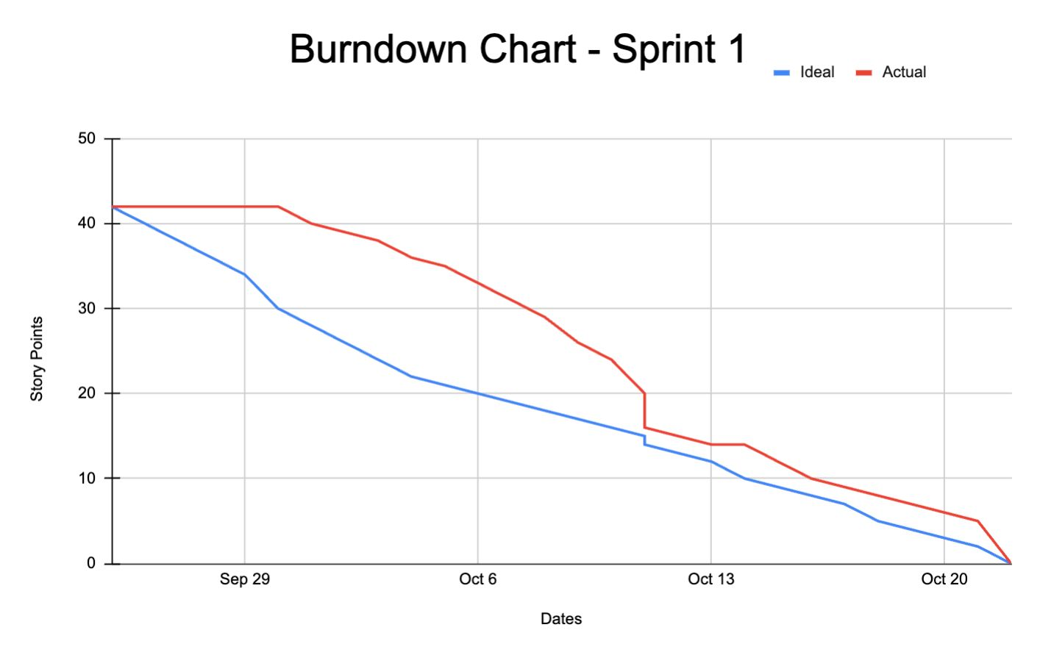
Team Velocity - This Sprint
Total Story Points Completed: 42 Points

Slide 38
Completed/Committed Ratio
Story Points Committed: 42 Points
Story Points Completed: 42 Points
Completed/Committed Ratio: 42/42 = 100%

Slide 39
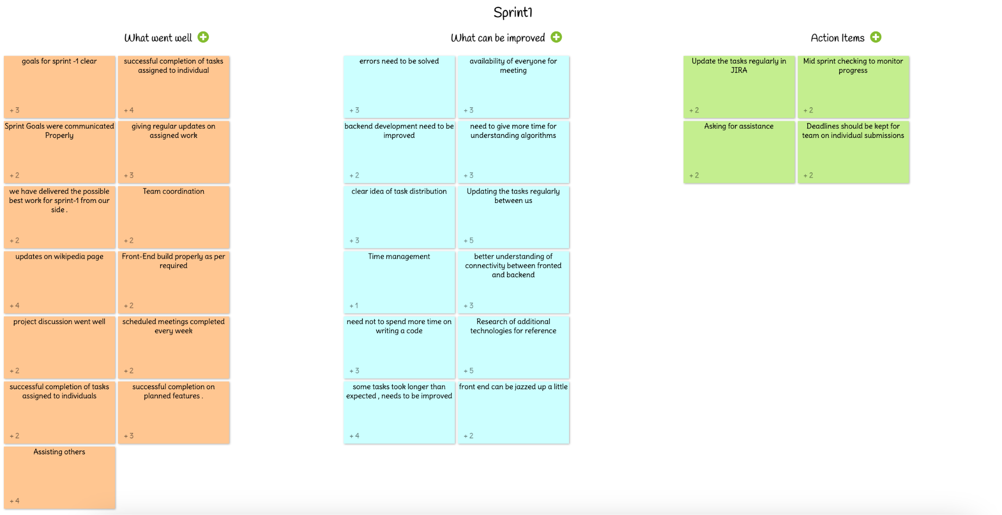
Retrospective

Slide 40
Sprint 2
# | Sprint | Story/Task | Story Points | Acceptance Criteria
1 | Sprint 2 | User Story 6: As a student, I want personalized content recommendations based on my performance so I can improve weak areas. | 8 Points | - The system provides content recommendations based on quiz performance and article difficulty. - Users are directed to articles covering weak areas.
2 | Sprint 2 | User Story 7: As a student, I want the app to implement spaced repetition to reinforce key concepts over time. | 8 Points | - The app identifies and schedules spaced repetition for topics users struggle with. - Users are prompted to revisit articles or take quizzes at optimal intervals.
3 | Sprint 2 | User Story 8: As a student, I want to track my progress in a performance dashboard. | 5 Points | - The dashboard shows quiz scores, articles read, and time spent on each subject. - Users can see areas of strength and weakness visually.
4 | Sprint 2 | User Story 9: As a student, I want to receive targeted feedback after quizzes so I can understand my mistakes. | 5 Points | - Detailed feedback is provided for each quiz question. - Feedback explains why certain answers are correct/incorrect.
5 | Sprint 2 | User Story 10: As a student, I want the app to dynamically adjust content difficulty based on my performance. | 8 Points | - The difficulty of content increases if the user performs well. - If a student struggles, simpler articles or review content is recommended.

Slide 41
Sprint 2
# | Sprint | Story/Task | Story Points | Acceptance Criteria
6 | Sprint 2 | Technical Story 5: Implement a basic machine learning model for personalized content recommendations. | 8 Points | - The ML model analyzes quiz performance and article difficulty to recommend personalized learning paths. - Adjustments are made based on user progress.
7 | Sprint 2 | Technical Story 6: Integrate spaced repetition algorithm to reinforce key concepts. | 8 Points | - Use spaced repetition techniques to schedule when users should revisit difficult topics. - Ensure the system prompts users at the right time for maximum retention.
8 | Sprint 2 | Technical Story 7: Build a performance dashboard to visualize progress. | 5 Points | - The dashboard shows quiz results, time spent, and subject mastery. - Visual charts display performance trends.
9 | Sprint 2 | Technical Story 8: Provide detailed quiz feedback for user learning. | 5 Points | - Implement feedback mechanisms to explain quiz results. - Feedback is both constructive and designed to reinforce learning.

Slide 42
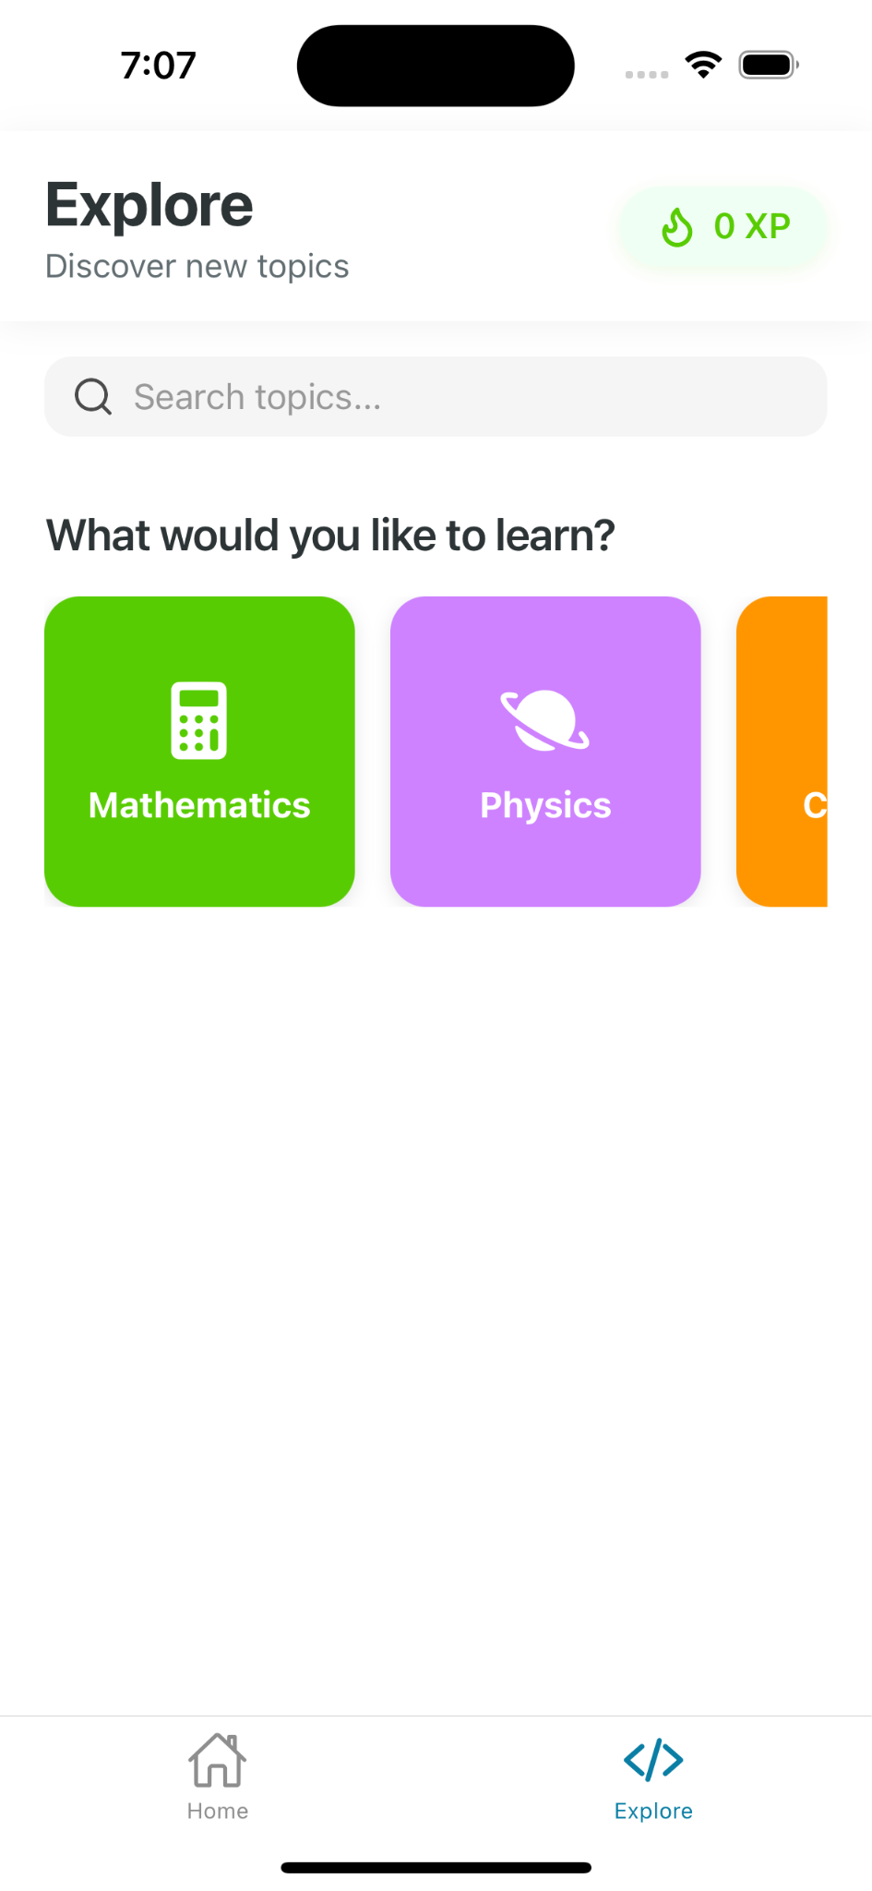
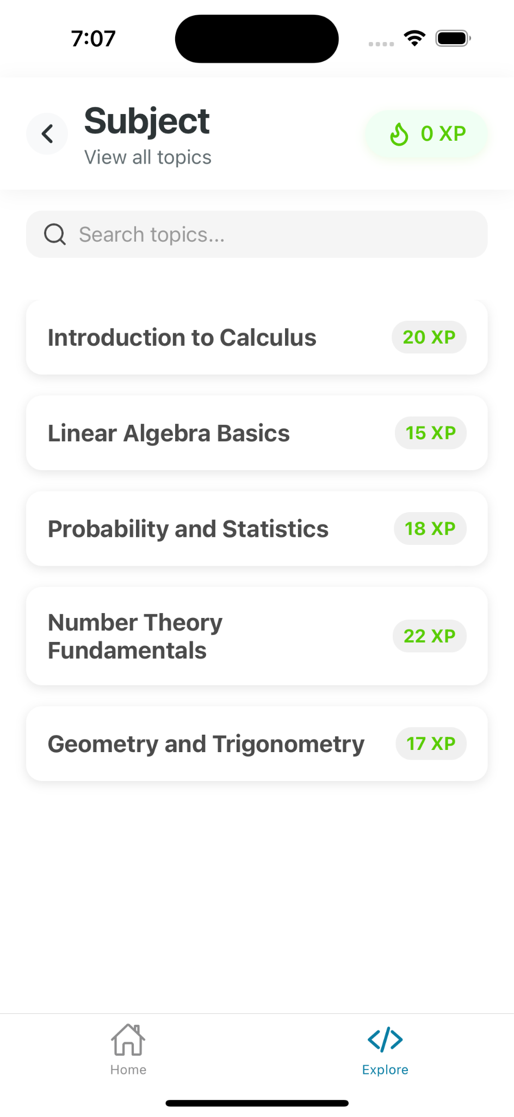
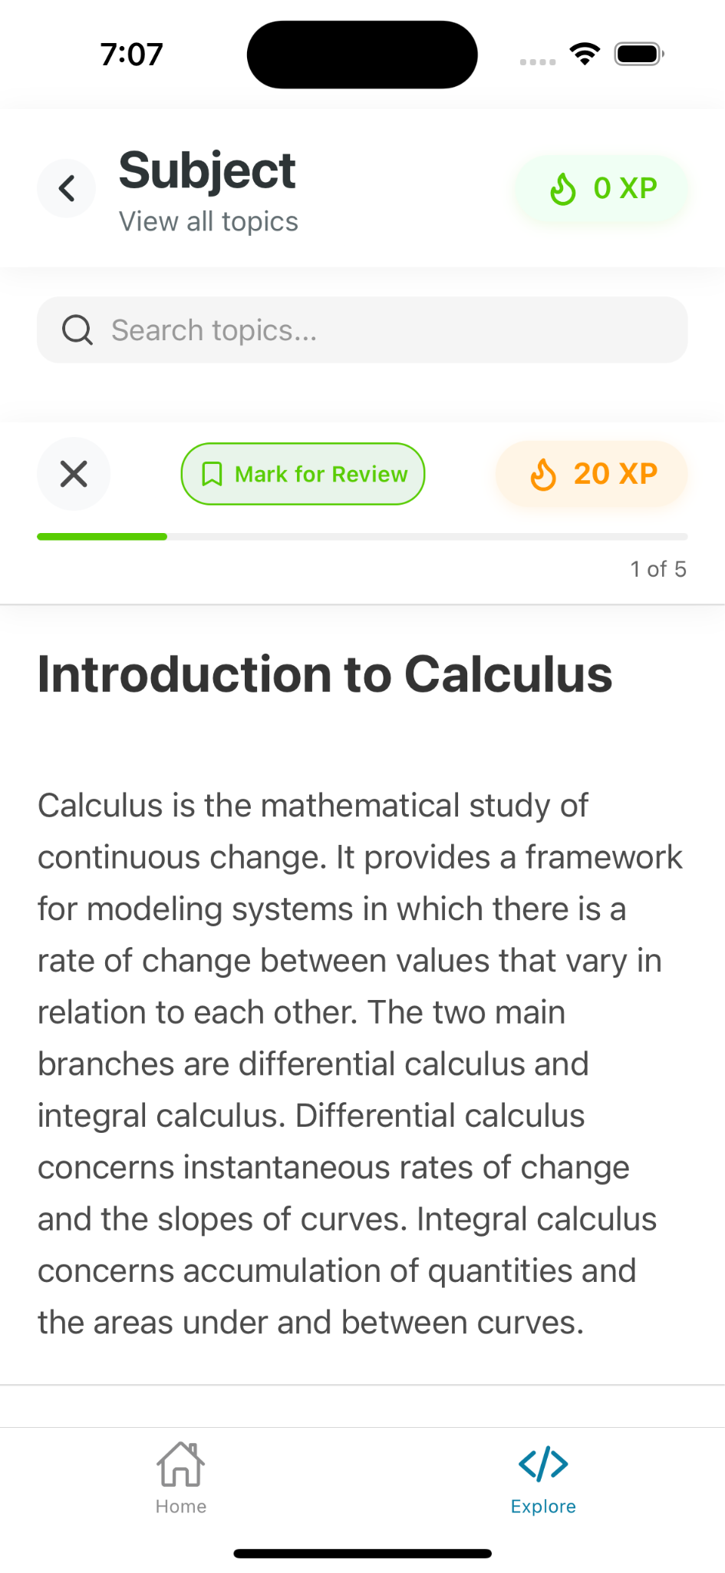
App Screenshots
Explore Screen
List of Lessons
Article screen

Slide 43
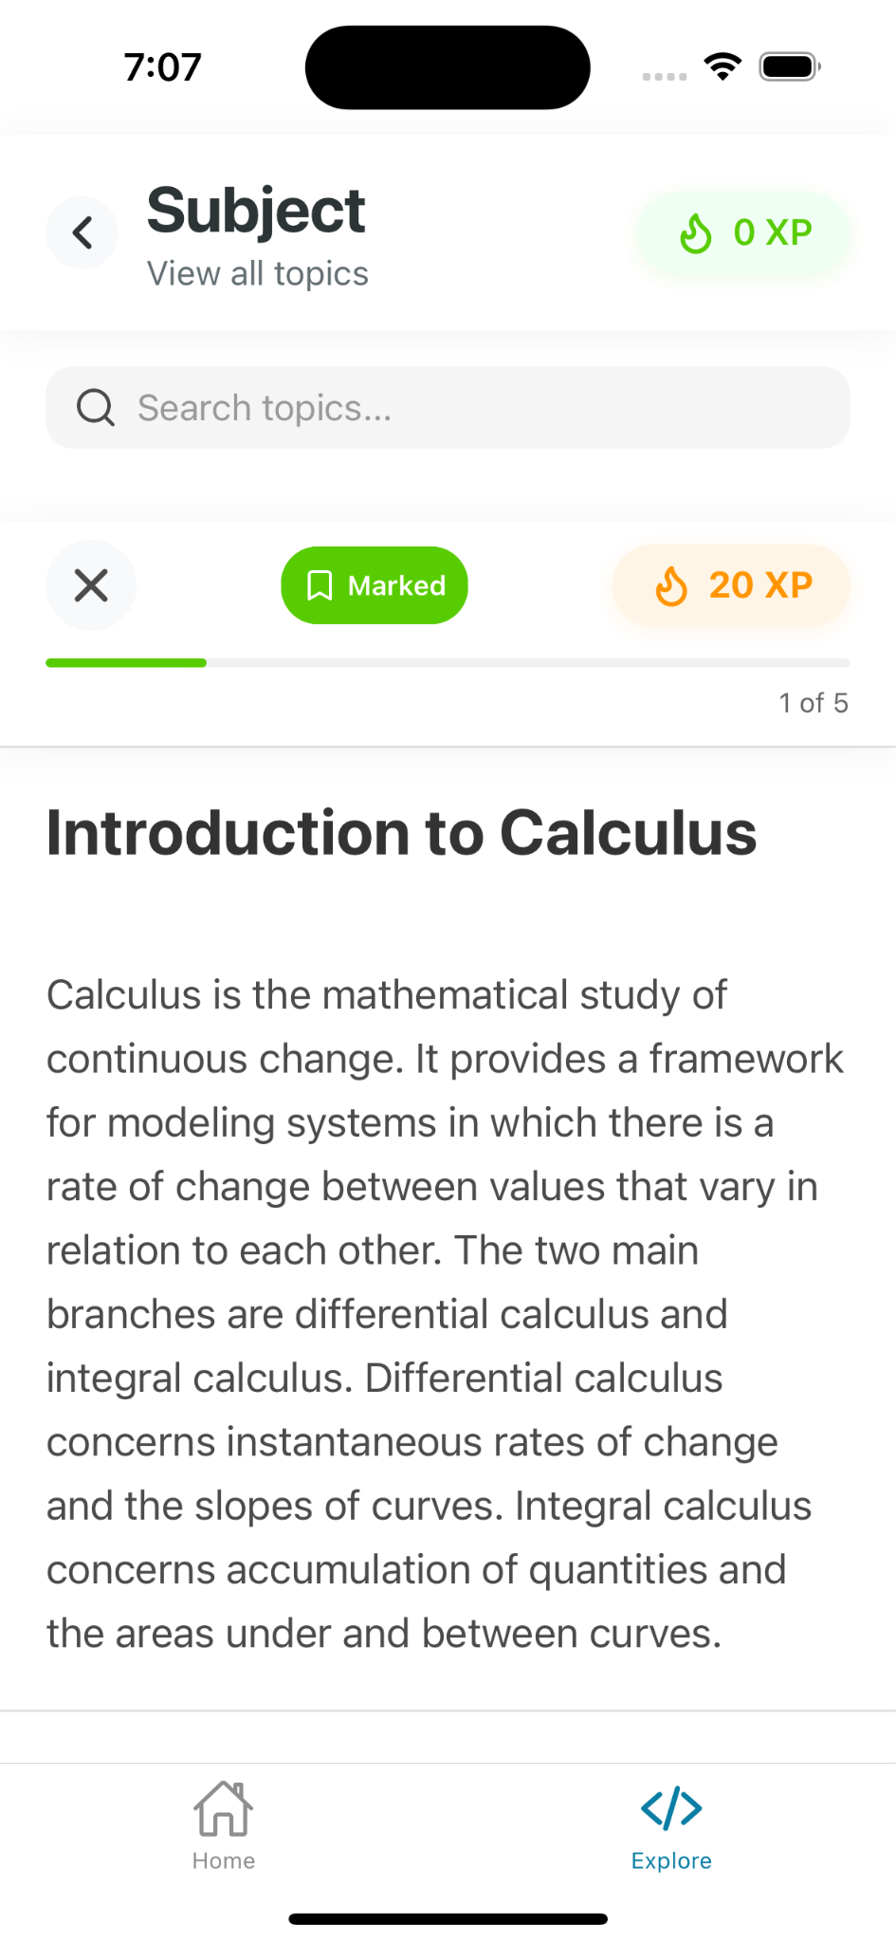
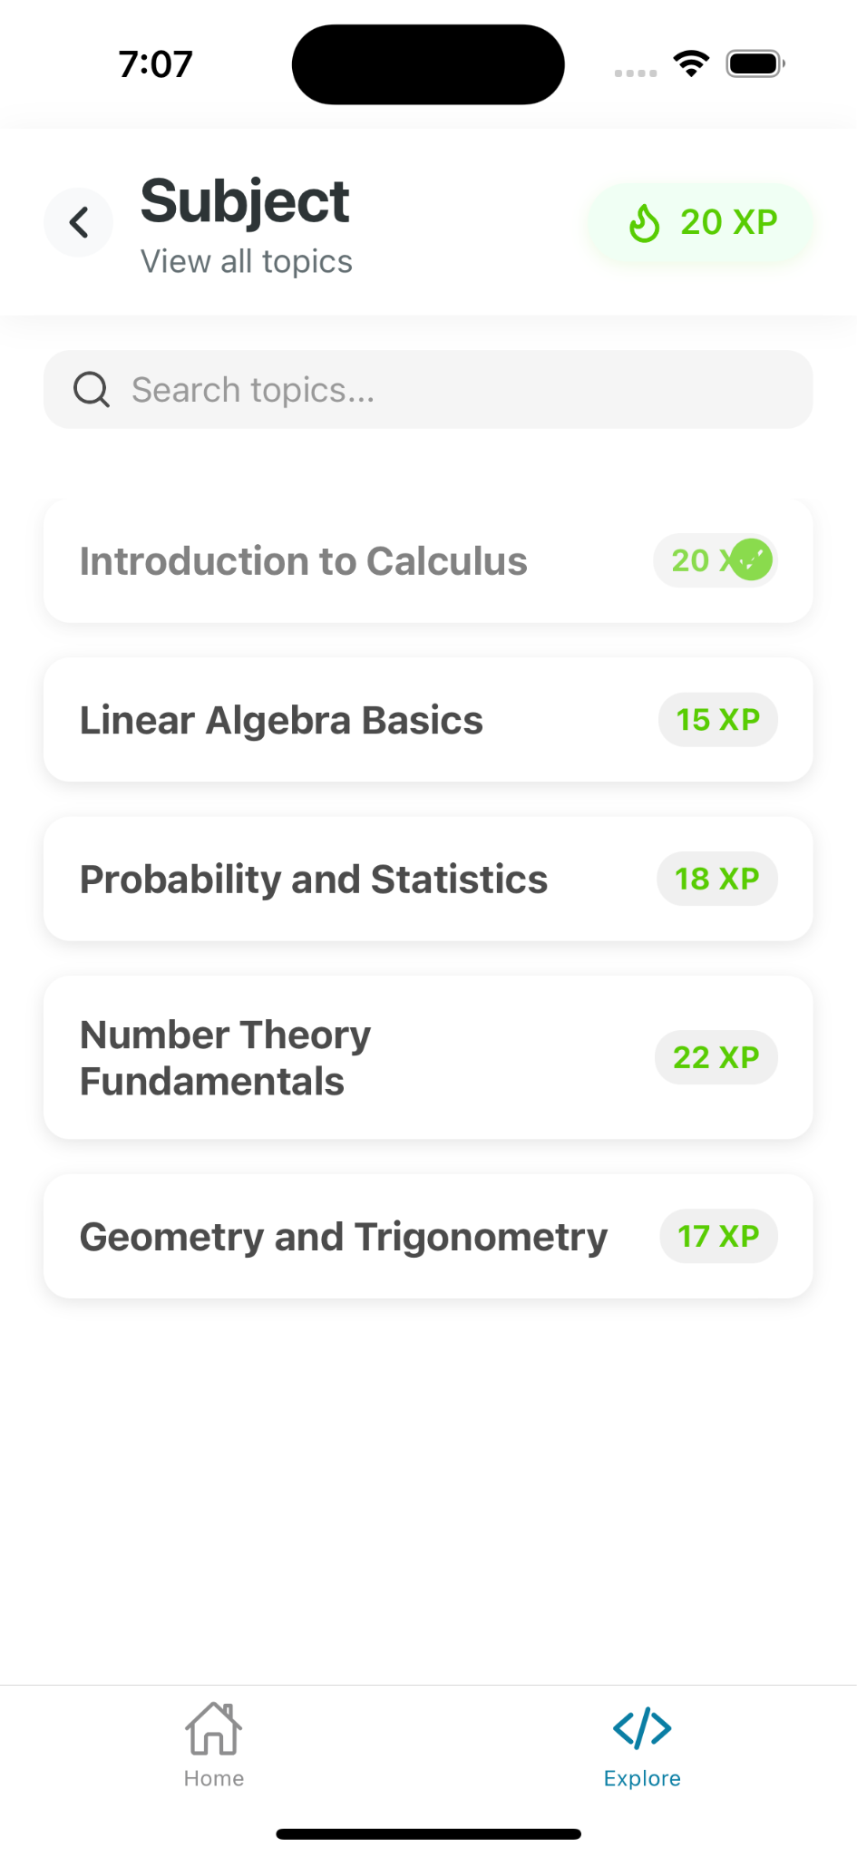
App Screenshots
When article is marketed to read later
When article is completed, adding of rewards

Slide 44
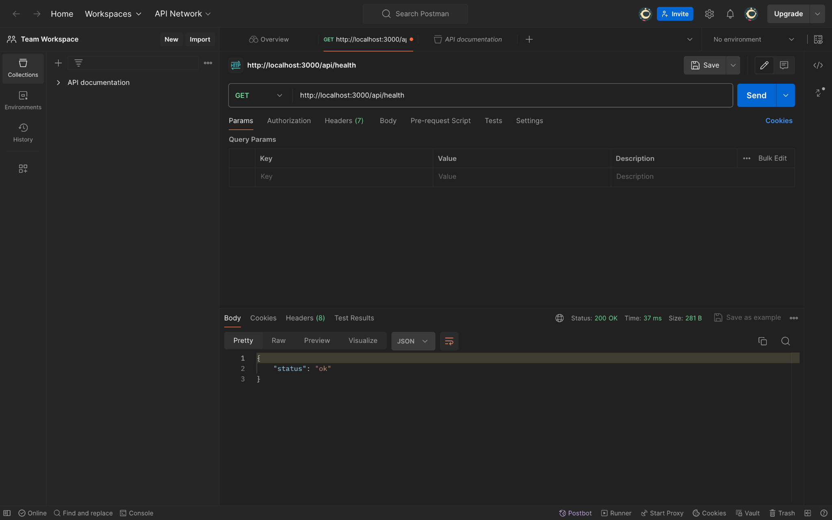
API

Slide 45
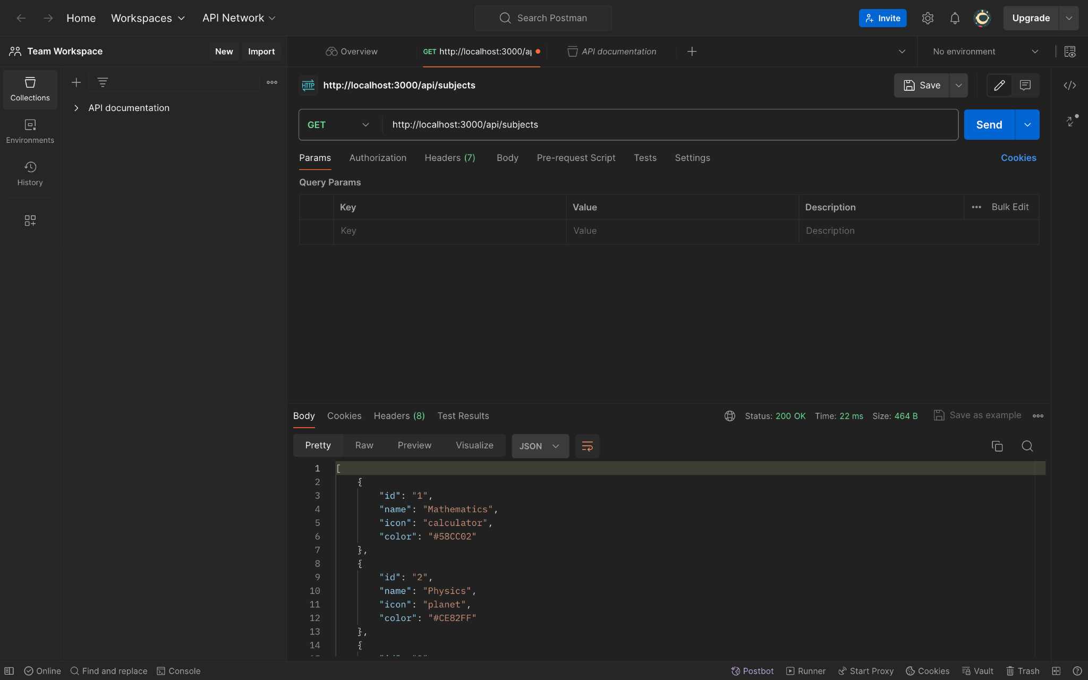
API

Slide 46
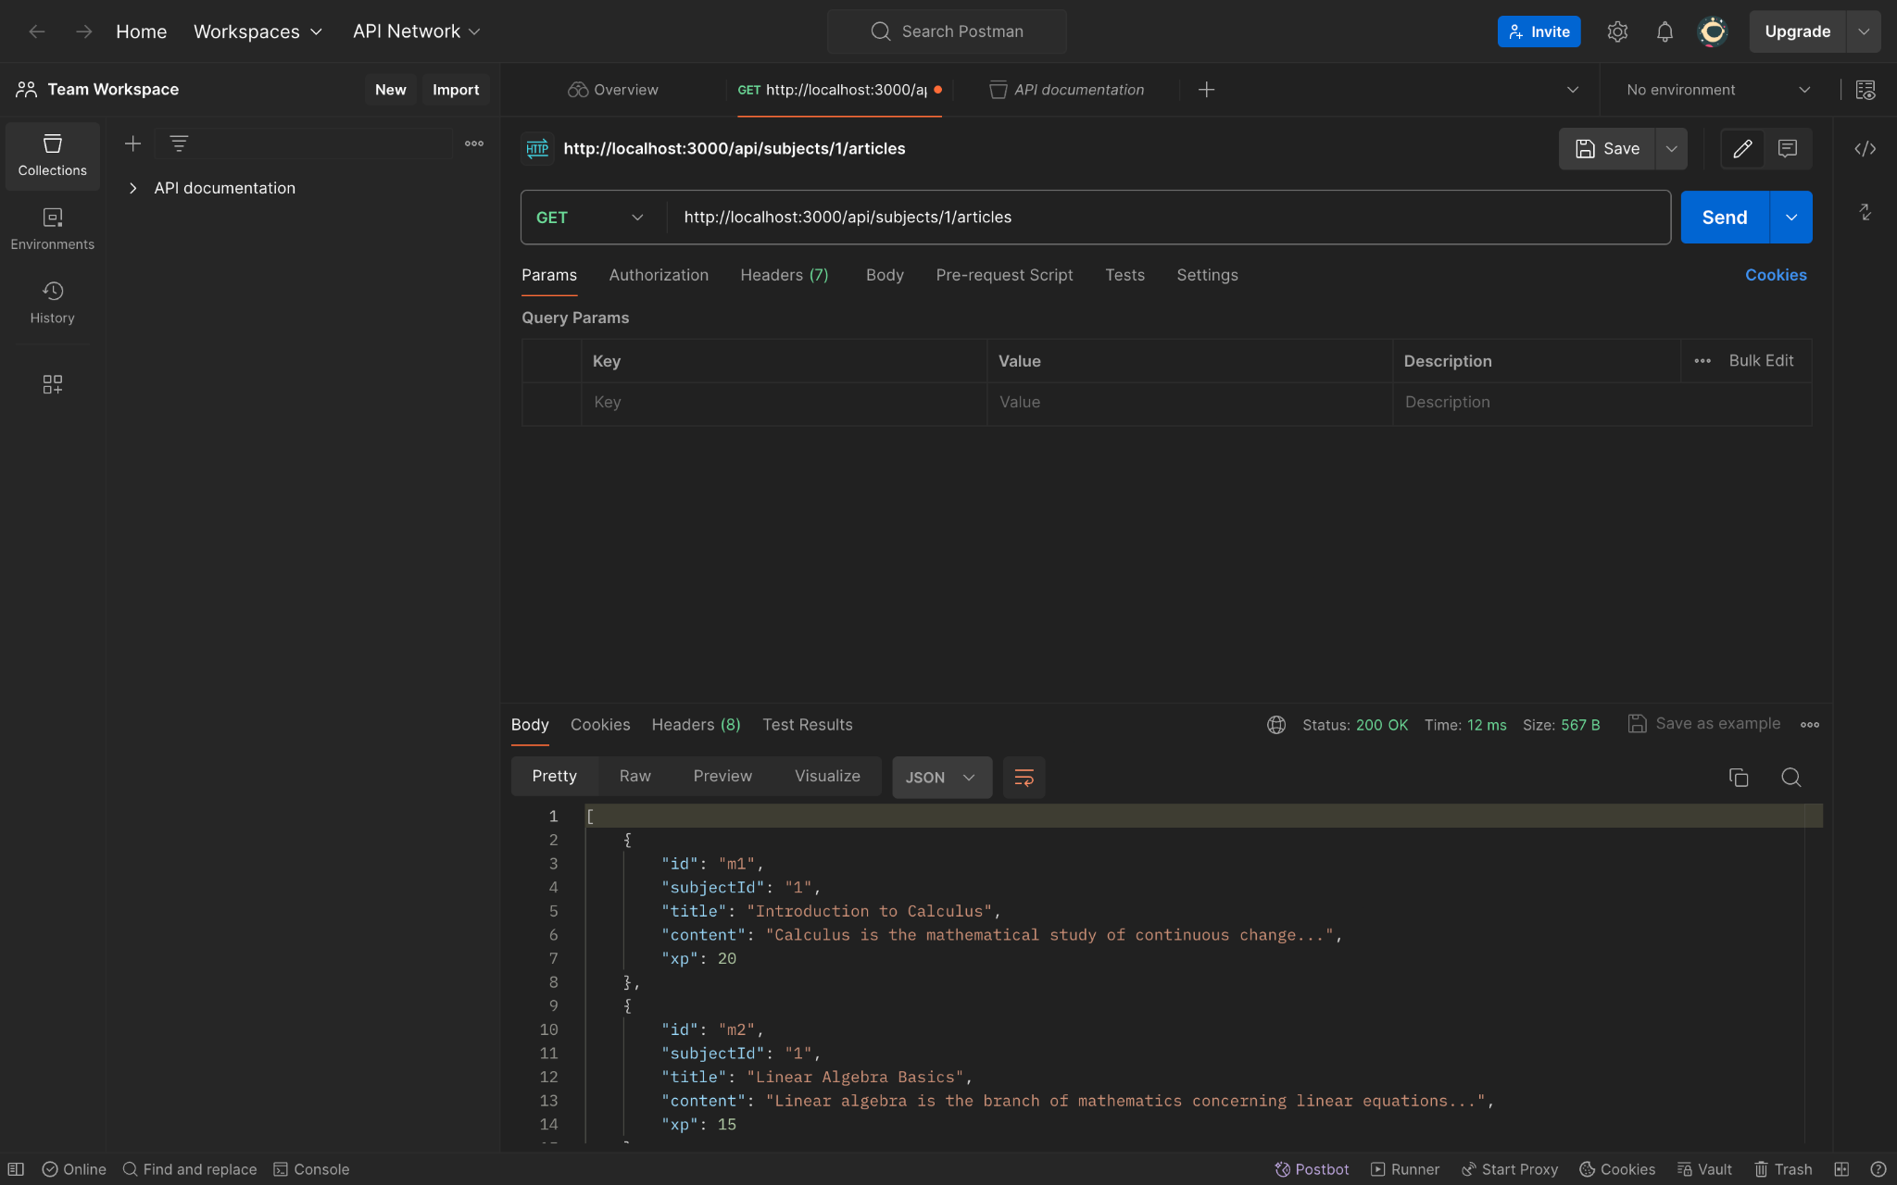
API

Slide 47

API

Slide 48
Wiki Link
https://github.com/htmw/2024F-Tech-Titans/wiki

Slide 49
Live Demo

